Slide 1

Emotional Intelligent
Name : Priyanshu Singh , Manik Khatta

Slide 2
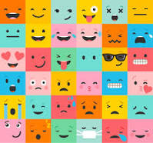
What are Emotion
Emotions are intense feelings linked to situations that are either real or imagined.
They are messages from the brain signalling that either a threat or reward has been identified in our environment.

Slide 3
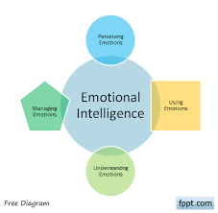
What are Emotion Intelligent
It is a capability of individuals to recognize their own emotions and those of others.
Its contain motivating ourselves and also for managing emotions and relations.

Slide 4
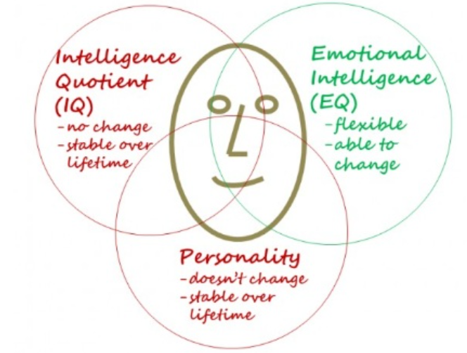
Emotional Intelligence(EQ), Intelligence(IQ), & Personality

Slide 5
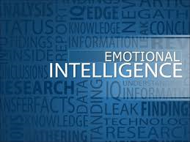
Why Emotional Intelligence
Self-Awareness. Understand the impact you have on the people around you.
Great Workplace Culture. Emotions are contagious. Improve relationship quality and build a culture of accountability.
Exceptional Leadership. People leave managers, not jobs. Exceptional leaders bring out the best in their people.

Slide 6
THANK YOU

